Slide 1
Day 2: Designing Apps with Docker

Slide 2
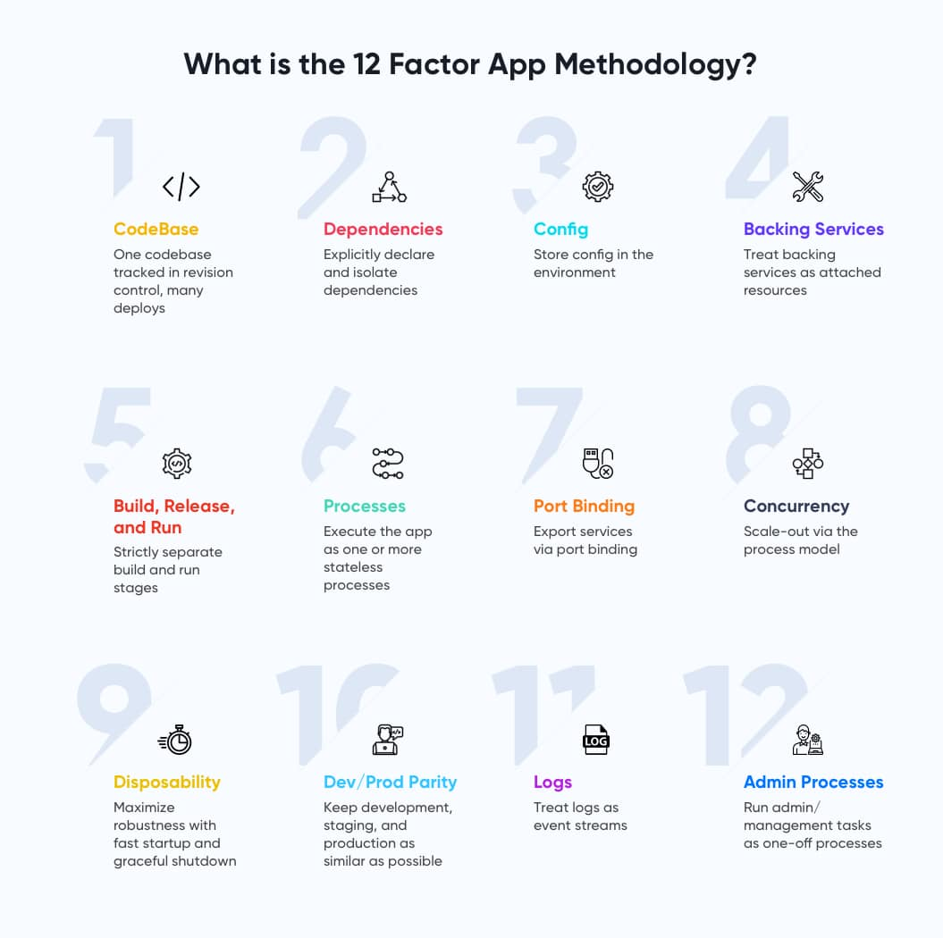

Slide 3
Pushing images to a repository
1. Build image and tag image locally
2. Tag image with repository name
3. Login to your repository with credentials or local docker secret
4. Perform a docker push on the image tage with repository destination.
docker image tag rhel-httpd:latest registry-host:5000/myadmin/rhel-httpd:latest
docker image push registry-host:5000/myadmin/rhel-httpd:latest

Slide 4
Quiz: What does each row do?
docker run -d \
--name mydb \
-e MYSQL_ROOT_PASSWORD=admin \
-p 3306:3306 \
mysql:latest

Slide 5
Containers are stateless
When restarting a container all data is lost!
We need to mount a volume
Bind: binds a directory inside the container to a directory on the host, not very scalable…also depends on the host machine.
Volume: creates a volume managed by docker (often distributed setup)
Mostly managed by your organization

Slide 6
Creating a volume in docker desktop
docker volume create mysql_data
docker volume ls

Slide 7
Using the volume inside the container
docker run -d \
--name mydb \
--detach
-e MYSQL_ROOT_PASSWORD=my-secret-password \
-v mysql_data:/var/lib/mysql \
-p 3306:3306 \
mysql:latest

Slide 8
Checking logs
docker logs mydb

Slide 9
Security in docker
Docker is actually running with root priviligies
A misconfigured volume or other potential errors can cause potential security risks.
Finding a way from the container to the host can be dangerous, the user can now modify the hosts system
Avoid running as root forever….
We can first do our root stuff and then change owner of all our dirs/files to a given user. We can then hardcode that user into our dockerfile.
More on this later!

Slide 10
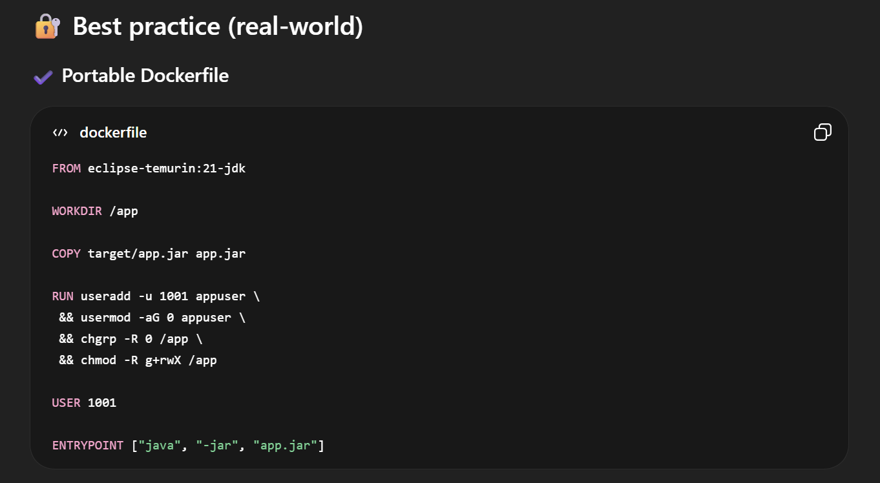
add user/group/permission then run as that user.

Slide 11
Problems with docker
If a machine hosting docker crashes app will not be available
We need setup a image repository thas is reachable from all machines
We need to expose our machines to the internet
Docker needs to be installed on multiple machines
Storage needs to be distributed.
Security needs to be handled manually
App health is not handled automatically, we need to restart app if it goes down.
We need store configs for each enviroment
We need to seperate different test and prod environments
We need some kind of overview of all our apps
Welcome to Kubernetes!

Slide 12
Openshift (Kubernetes) development

Slide 13
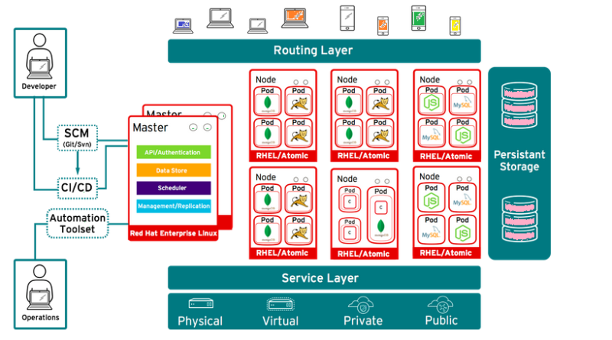
Pods Run on Nodes

Slide 14
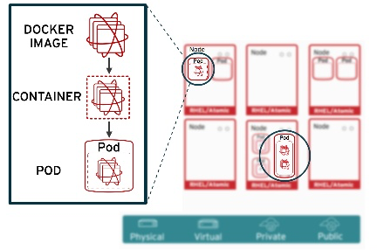
Pods Architecture

Slide 15
Openshift vs Kubernetes CLI
Most commands in the openshift CLI is identical with the Kubernetes CLI
Kubernetes uses kubectl commands
Openshift uses oc commands
Openshift is fully compliant with Kubernetes, and therefore you can run kubectl commands in openshift
oc contains all commands in kubectl + a lot more openshift specific commands

Slide 16
CLI documentation
https://kubernetes.io/docs/reference/generated/kubectl/kubectl-commands
https://www.mankier.com/1/oc-run

Slide 17
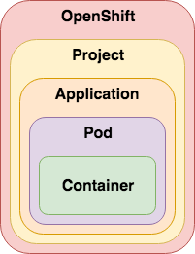
Project structure
Each applications should have its own project/namespace.
Each application can have multiple pods.
Each pod can also have multiple containers

Slide 18
Openshift/Kubernetes objects
All objects in openshift are describe using yaml or json
Yaml files describes the state/and configuration of our application
Lets have a look at a simple app structure in openshift.

Slide 19
Pods Background
We want to have pod for each service (Frontend and Backend are 2 seperate services)!
Keeping track of the application configuration and state, since we have a declared yaml file.
Pod configurations are compatible with other internal openshift objects, such as persistent volumes and configmaps.

Slide 20
Pods
repository.arbetsformedlingen.se:5000/nginx:1.14.2

Slide 21
15 minute Excercise Pods
Find out how to spin up a pod with the httpd image in Kubernetes
You can use the --dry-run=client flag to verify object before creation.
Find out how to exec into the container in and run some command.

Slide 22
Background Deployments
A deployment will make sure that the desired application state is maintained.
Lets say that we always want to have 3 replicas of a pod, a deployment will try to restart pods if they fail.
We can also specify which strategy to use for our deployment (more on this later)

Slide 23
Deployments
Labels need to match in the pod.
A pod definition inside the deployment object is defined

Slide 24
15 minutes excercise Deployments
Use the kubernetes documentation in combination with the yaml for the httpd pod, to wrap a httpd pod inside a deployment with 3 replicas.
Find out the correct kubectl command to set a new image version of httpd to 2.4 in the deployment
What will happen to all the pods?
Now go to one of your pods and delete them with the CLI
Dont delete the deployment!
The deployment will try to spin the desired number of pods again.

Slide 25
Links
Kubernetes/openshift docs:
https://kubernetes.io/docs/home/
https://docs.openshift.com/container-platform/4.11/welcome/index.html
Kubectl CLI reference guide (Try the examples here in docker desktop)
https://kubernetes.io/docs/reference/generated/kubectl/kubectl-commands

Slide 26
Next time
We will move our pods into Azure and run them inside the cloud environment and learn which tools we can use inside Azure to support docker/container development!

